Slide 1
Artificial intelligence & machine learning
Contents: Adversarial Search:Mini Max Algorithm

Slide 2
Adversarial Search
Examine the problems that arise when we try to plan ahead in a world where other agents are planning against us.
A good example is in board games.
Adversarial games, while much studied in AI, are a small part of game theory in economics.

Slide 3
Typical AI assumptions
Two agents whose actions alternate
Utility values for each agent are the opposite of the other
  creates the adversarial situation
Fully observable environments
In game theory terms: Zero-sum games of perfect information.
We’ll relax these assumptions later.

Slide 4
Search versus Games
Search – no adversary
  Solution is (heuristic) method for finding goal
  Heuristic techniques can find optimal solution
  Evaluation function: estimate of cost from start to goal through given node
  Examples: path planning, scheduling activities
  Games – adversary
  Solution is strategy (strategy specifies move for every possible opponent reply).
  Optimality depends on opponent. Why?
  Time limits force an approximate solution
  Evaluation function: evaluate “goodness” of game position
  Examples: chess, checkers, Othello, backgammon

Slide 5
Types of Games
 | deterministic | Chance moves
Perfect information | Chess, checkers, go, othello | Backgammon, monopoly
Imperfect information (Initial Chance Moves) | Bridge, Skat | Poker, scrabble, blackjack
Notes:
If Nature is not a player, then poker etc. involve chance moves like drawing cards, tiles. The other card games involve no more chance. Play with class.

Slide 6
Game Setup
Two players: MAX and MIN
MAX moves first and they take turns until the game is over
  Winner gets award, loser gets penalty.
Games as search:
  Initial state: e.g. board configuration of chess
  Successor function: list of (move,state) pairs specifying legal moves.
  Terminal test: Is the game finished?
  Utility function: Gives numerical value of terminal states. E.g. win (+1), lose (-1) and draw (0) in tic-tac-toe or chess
Notes:
Explain these conventions carefully. Maybe contrast with general game trees.

Slide 7
Size of search trees
b = branching factor
d = number of moves by both players
Search tree is O(b^{d})
Chess
  b ~ 35
  D ~100
  - search tree is ~ 10 ¹⁵⁴ (!!)
  - completely impractical to search this
Game-playing emphasizes being able to make optimal decisions in a finite amount of time
  Somewhat realistic as a model of a real-world agent
  Even if games themselves are artificial

Slide 8
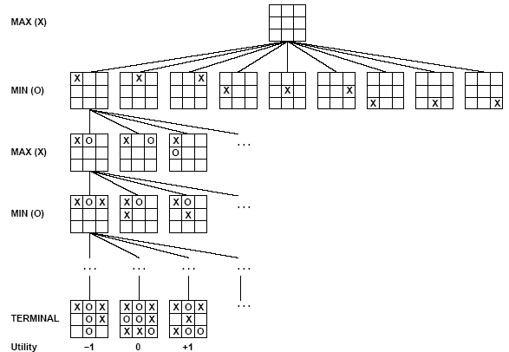
Partial Game Tree for Tic-Tac-Toe

Slide 9
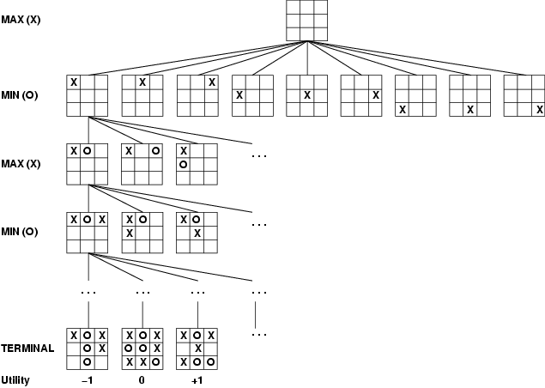
Game tree (2-player, deterministic, turns)
How do we search this tree to find the optimal move?
Notes:
Add tic-tac-toe demo.

Slide 10
Minimax strategy:
Find the optimal strategy for MAX assuming an infallible MIN opponent
  Need to compute this all the down the tree
  Game Tree Search Demo
Assumption: Both players play optimally!
Given a game tree, the optimal strategy can be determined by using the minimax value of each node.
Zermelo 1912.

Slide 11
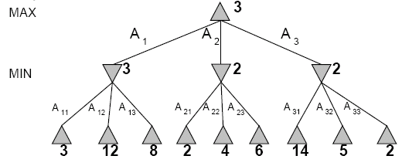
Two-Ply Game Tree
Notes:
Chocolate playing: max gets x number of chocolates, min has to give up x number of chocolates.

Slide 12
Two-Ply Game Tree

Slide 13
Two-Ply Game Tree
Notes:
Ply = 2 half moves

Slide 14
Two-Ply Game Tree
Minimax maximizes the utility for the worst-case outcome for max
The minimax decision

Slide 15
What if MIN does not play optimally?
Definition of optimal play for MAX assumes MIN plays optimally:
  maximizes worst-case outcome for MAX
But if MIN does not play optimally, MAX will do even better
  Can prove this (Problem 6.2)

Slide 16
Pseudocode for Minimax Algorithm
function MINIMAX-DECISION(state) returns an action
inputs: state, current state in game
v←MAX-VALUE(state)
return the action in SUCCESSORS(state) with value v
function MAX-VALUE(state) returns a utility value
if TERMINAL-TEST(state) then return UTILITY(state)
v ← -∞
for a,s in SUCCESSORS(state) do
v ← MAX(v,MIN-VALUE(s))
return v
function MIN-VALUE(state) returns a utility value
if TERMINAL-TEST(state) then return UTILITY(state)
^{v ← ∞}
for a,s in SUCCESSORS(state) do
^{v ← MIN(v,MAX-VALUE(s))}
^{return v}

Slide 17
Example-1

Slide 18
Cont…

Slide 19
Cont…

Slide 20
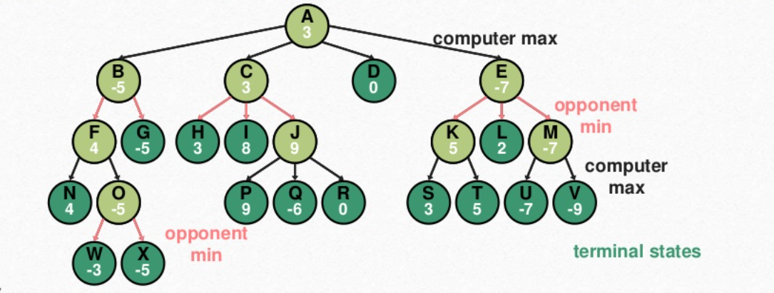
Example-2

Slide 21
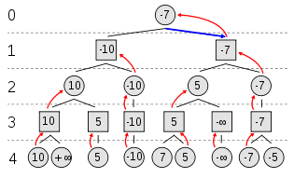
Example-3

Slide 22
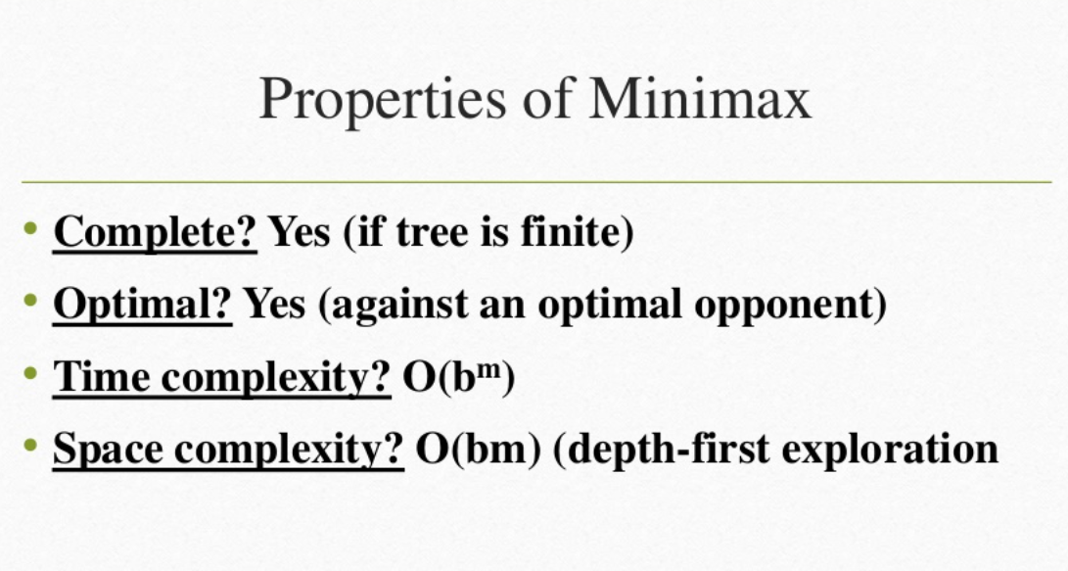

Slide 23
Thank you

